Slide 1

Process Mining Virtual Internship
by
Neeha N
Roll No. 214G1A3264
Department of Computer Science and Engineering (Data Science)
Srinivasa Ramanujan Institute of Technology
(Affiliated to JNTUA & Approved by AICTE) (Accredited by NAAC with ‘A’ Grade & Accredited by NBA (EEE, ECE & CSE)
Rotarypuram Village, B K Samudram Mandal, Ananthapuramu – 515701.
2023 - 2024

Slide 2
Contents
Course Objective
Introduction
Technology
Applications
Modules
Real Time applications
Learning outcomes
GitHub Link
Queries

Slide 3
Course Objective
Understanding the fundamental concepts of process mining.
Gain Practical Experience, Improve Data Analysis Skills, Understand Business Processes, Collaborate and Communicate Effectively, Contribute to Process Improvement, Networking and Career Development.
Understanding the principles of process mining.

Slide 4
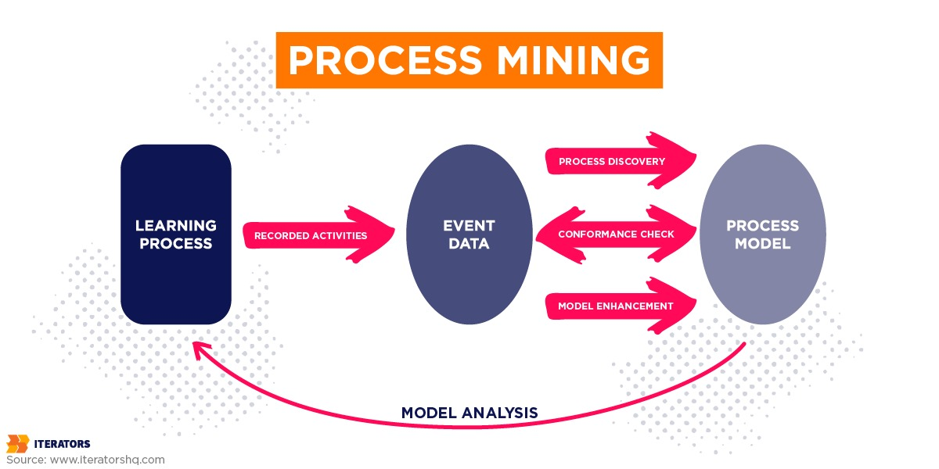
Introduction
Process mining is a process management technique used to discover, monitor, and improve processes.
It provides a systematic approach to understanding how processes actually operate within an organization.
It works by extracting knowledge from
event logs(also called digital footprints).

Slide 5
Introduction
The goal of using process mining is to explore where existing business processes are inefficient and address those critical areas.
These data logs can come from various sources, including:
IT systems: Such as Enterprise Resource Planning (ERP), Customer Relationship Management (CRM), and Workflow Management Systems.
Web applications: Like e-commerce platforms, websites, and mobile apps.
IoT devices: Sensors and machines that generate event data.
Log files: Records of activities, actions, and interactions.

Slide 6
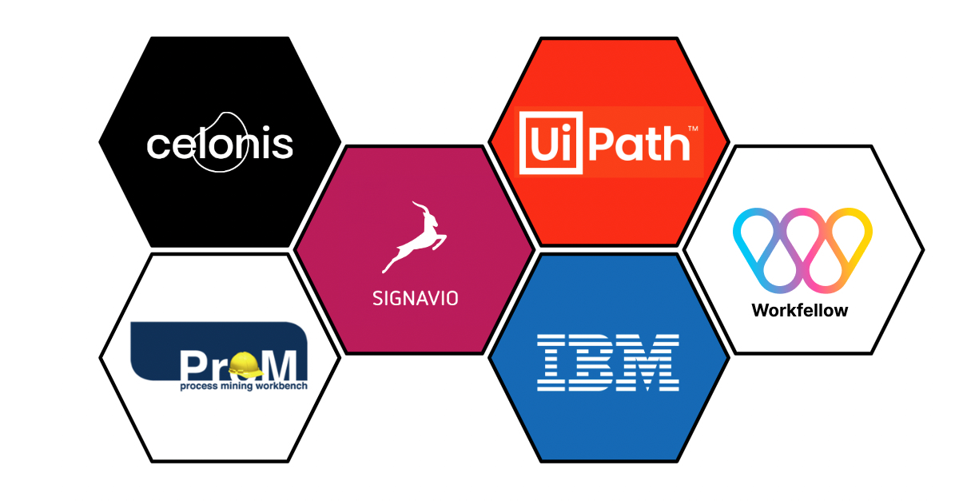
Tools for Process Mining
Celonis is a leading software company specializing in Process Mining and Process Excellence.The celonis process mining platform is called the Execution Management System (EMS). the EMS offers a cloud-based solution for real-time data extraction and analysis, as well as task mining functionality.
The key features of celonis are:
Collaboration
Business Rules Management
Process Change Tracking
Process Mapping
Process Modeling & Designing

Slide 7
Technology
Event Log Data: The foundational technology for process mining is event log data. This data is generated by various IT systems, applications, and devices and captures information about activities, actions, timestamps, case identifiers, and other relevant details related to the execution of a process.
Conformance Checking Techniques:
Token-Based Replay: This technique checks how well an event log aligns with a process model by simulating the execution of the model and comparing it to the log.
Alignment Analysis: It provides detailed insights into deviations between the process model and the actual process execution.

Slide 8
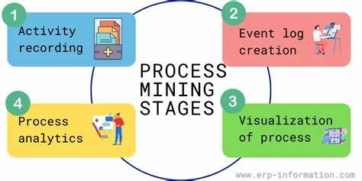
Technology
Process Enhancement and Optimization Tools:
Simulation: Process simulation tools allow organizations to model and test changes to processes in a risk-free environment before implementation.
Predictive Analytics: Machine learning and predictive analytics can be used to forecast future process behavior based on historical data, helping organizations make proactive decisions.

Slide 9
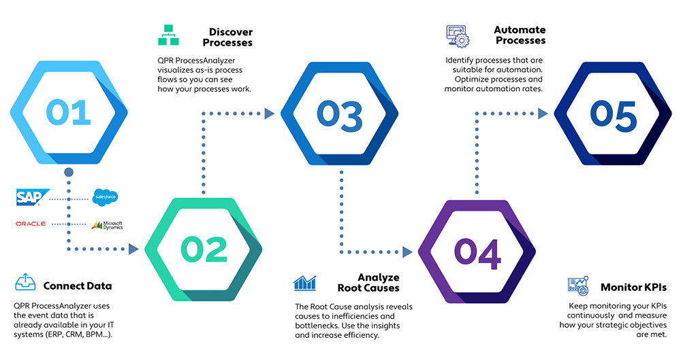
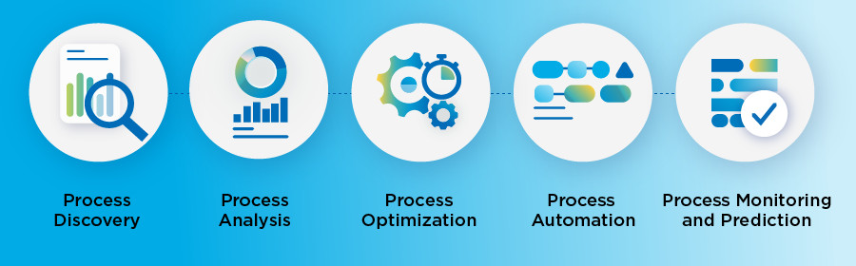
Process Mining Steps:
These are the 5 valuable steps to increase productivity and efficiency of your process.

Slide 10
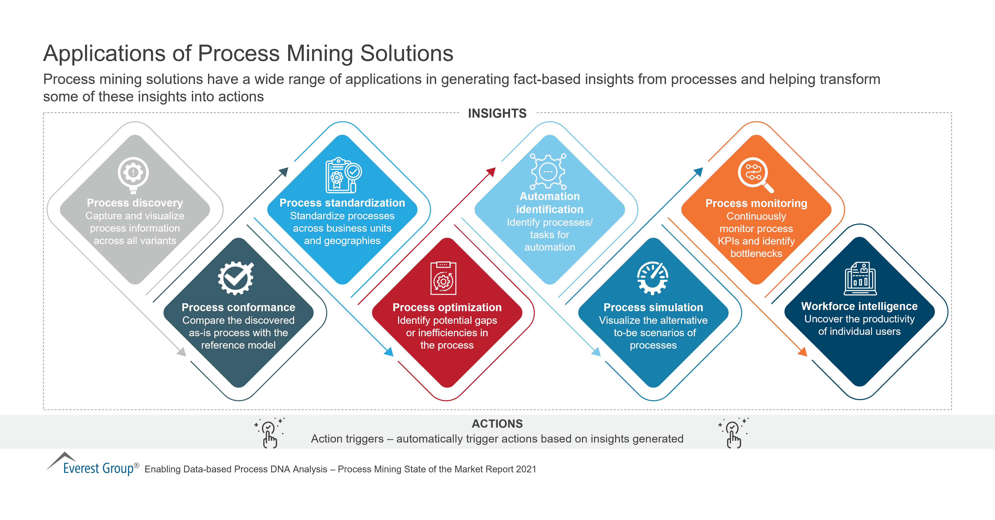
Applications

Slide 11
Modules
Data Collection and Preprocessing:
Data Extraction: This module involves extracting event data from various sources such as databases, logs, or application systems.
Data Cleaning: Raw data often contains errors, duplicates, or missing values. Data cleaning involves preprocessing the data to ensure its quality and reliability.
Data Transformation: Data may need to be transformed to a suitable format for process mining tools.

Slide 12
Modules
Data Storage and Management:
Event Log Storage: Event logs, which capture the sequences of events in a process, need to be stored and managed efficiently for analysis.
Data Integration:
Data Integration: In cases where data comes from multiple sources, integration modules are used to combine data and create a unified event log.
Process Discovery: This is the core module of process mining. It automatically generates process models from event logs. There are several process discovery techniques, such as:
Alpha Algorithm: Discovering a Petri net model.
Heuristic Mining: Identifying patterns and dependencies in the data.
Inductive Mining: Building a model by generalizing from individual cases.

Slide 13
RealTime Applications
Healthcare:
Patient Care: Process mining is used to optimize patient care processes, reduce wait times, and improve the overall patient experience in healthcare settings.
Clinical Pathways: It helps analyze and optimize clinical pathways for patients, ensuring that the most effective and efficient treatment plans are followed.

Slide 14
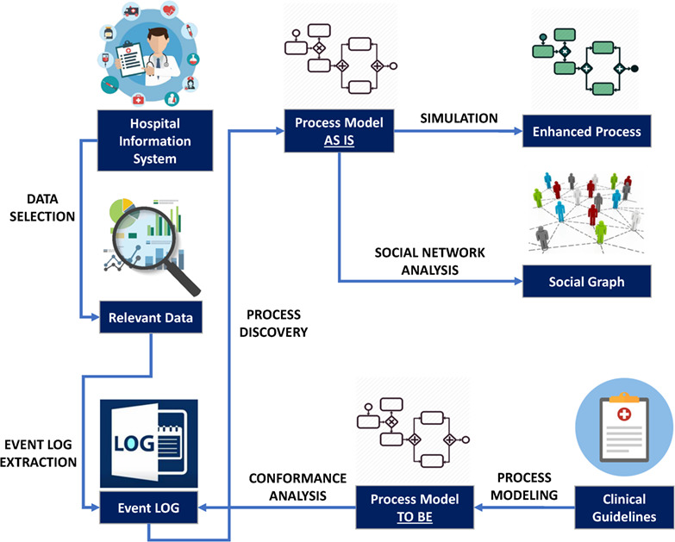
Healthcare

Slide 15
Learning Outcomes
Understanding of Process Mining Concepts
Data Analysis Skills
Performance Analysis
Career development
Critical thinking

Slide 16
Git Hub Dashboard

Slide 17
Any Queries?

Slide 18
Thank You!!!

